Slide 1
After Dusk
A VR Survival game

Slide 2
What has been implemented
New Enemy Behaviours - Surround Behaviour, Intercept and Follow Waypoints
Small Inventory System - Wrist Pockets - This allows the player to place anything inside they wish to carry
Game Optimisations - Fixed player movement, Added LOD to trees
Terrain system - Random Generation of the map
Health Bar - Enemy Health bars

Slide 3
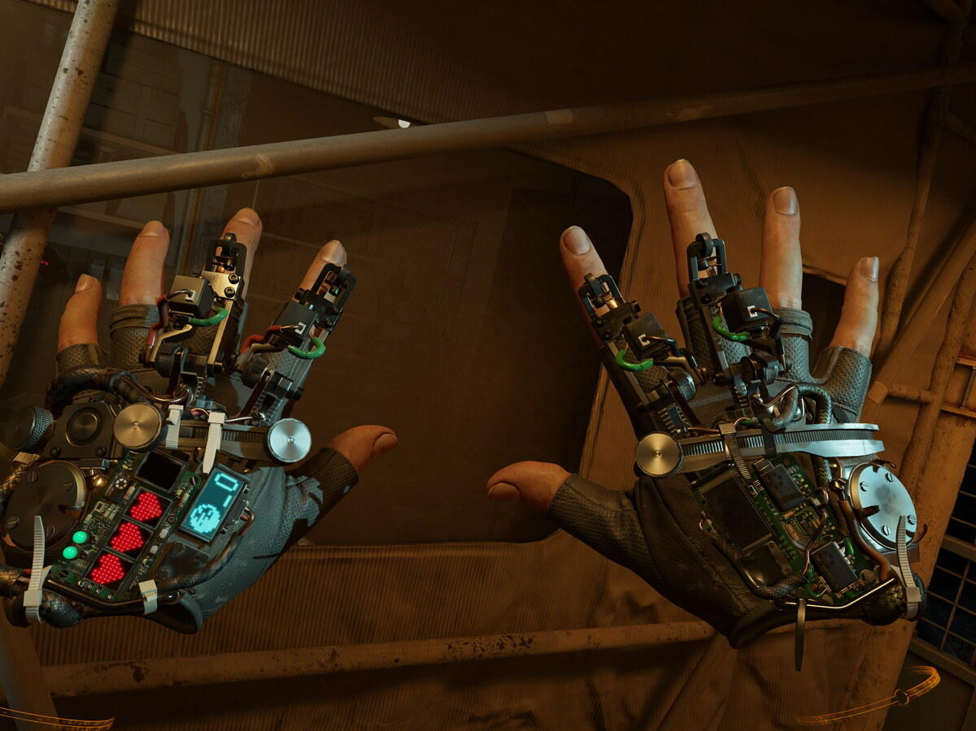
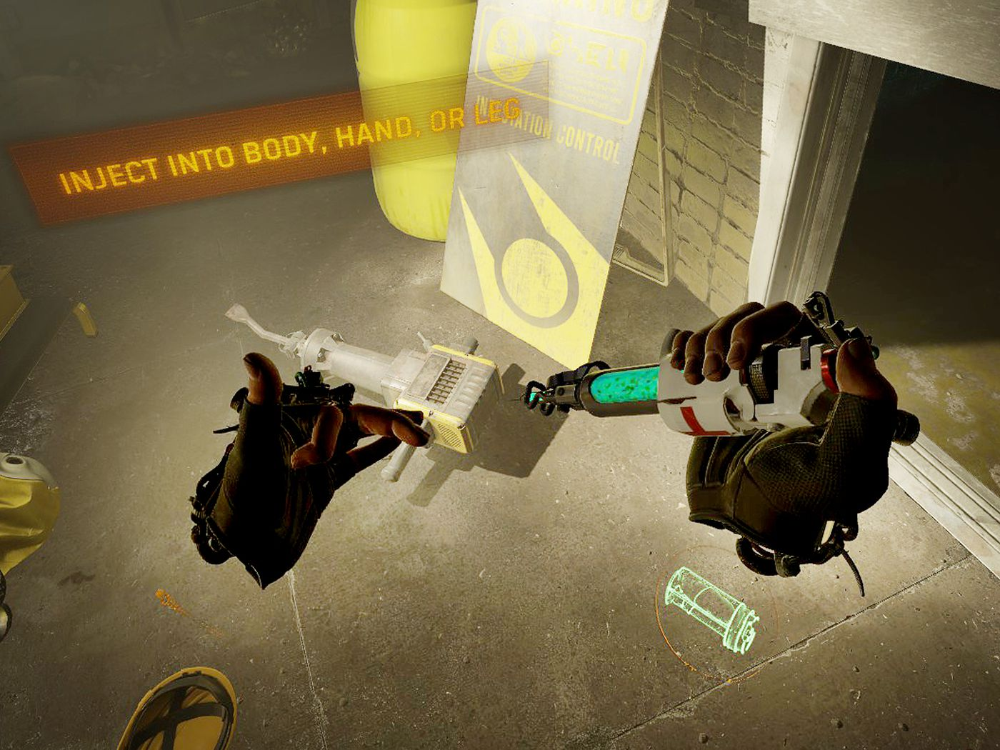
Features to come / Work In Progress
Compass System
Building of wrecked vehicle
More weapons (Grenades, ARs)
Health Pickups for player
Improved HUD

Slide 4
Video Link
Video Link

